Slide 1


Southeast Airlines
East
A Brief Data Analysis by Sam Bull

Slide 2
A Few New Categories…on top of the ones provided
Total Money Spent (Adding Shopping Amount with Eating and Drinking Amount)
Arrival Delay More than 5 minutes (Yes or No)
Detractor (Yes or No)
Flight Delay in Total (Adding Departure and Arrival Delay Times)
Long Trip Duration (True or False)
NPS Category (Promoter, Detractor, or Passive
Disclaimer:
I omitted every row with an NA in the place of a value AND omitted the ”states” of Alaska, Hawaii, and Puerto Rico in my maps

Slide 3
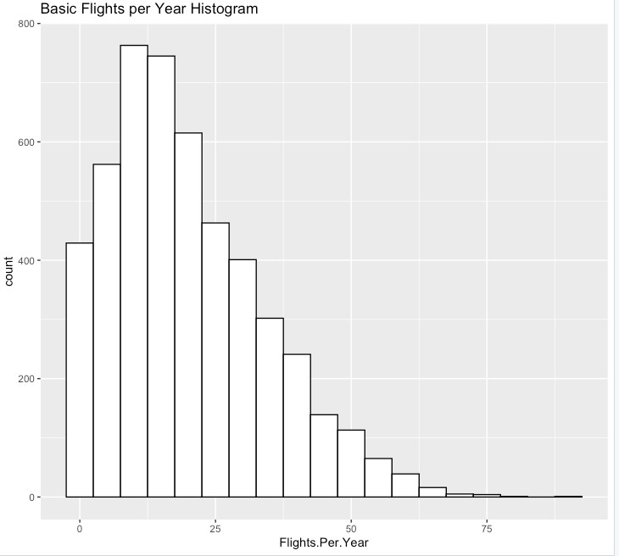
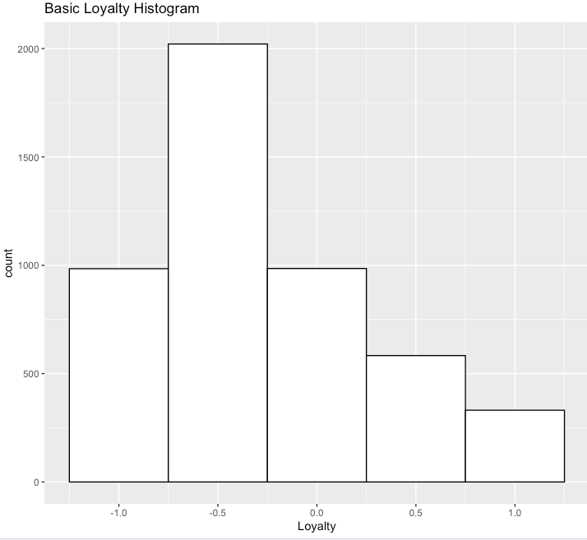
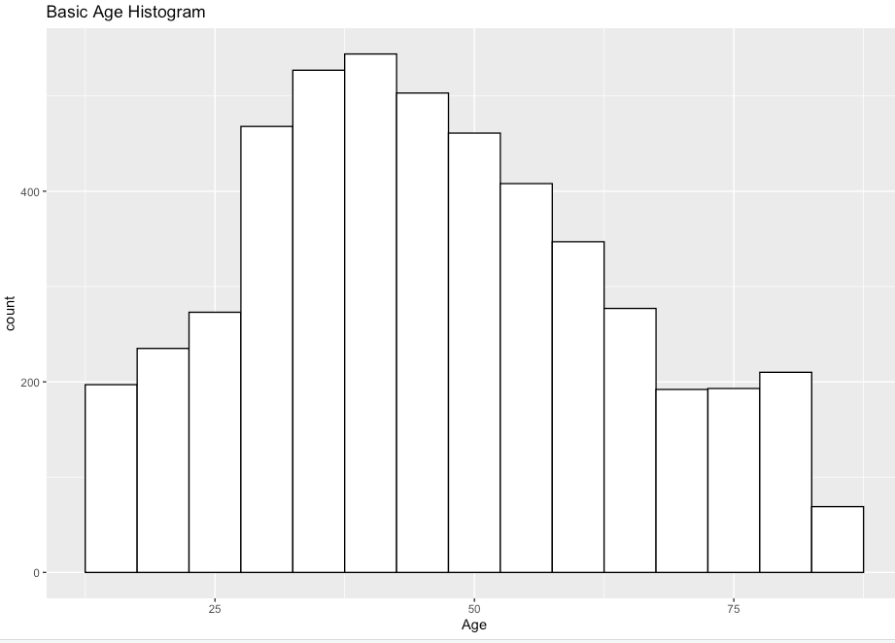
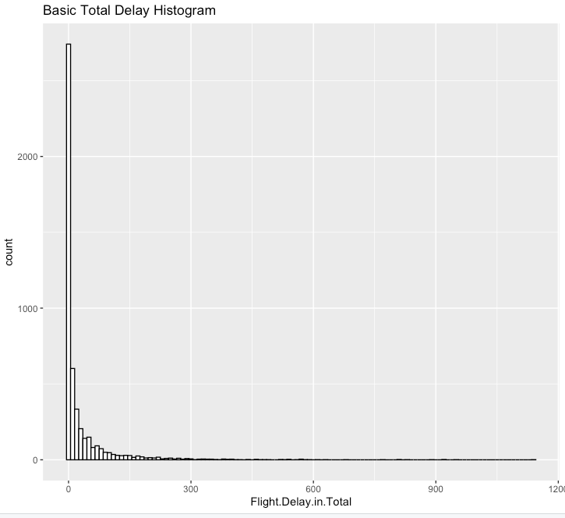
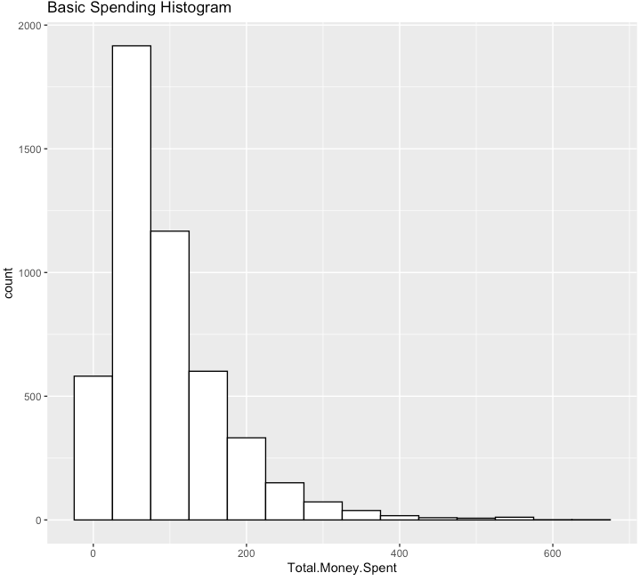
Basic Histograms
Age
Flights per Year
Loyalty to Southeast
Total Delay Time
Total Spending

Slide 4
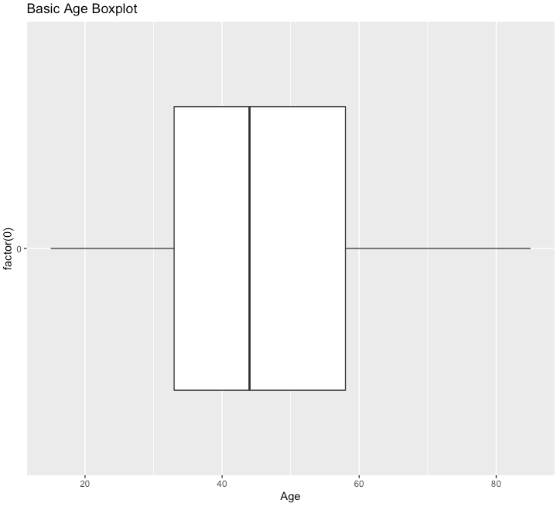
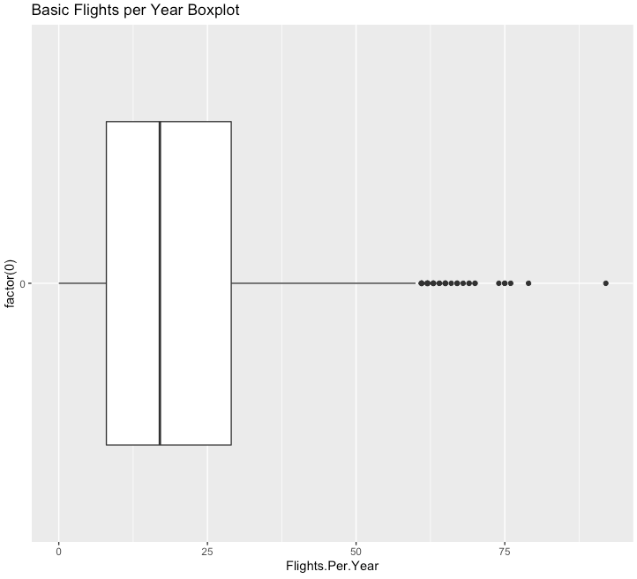
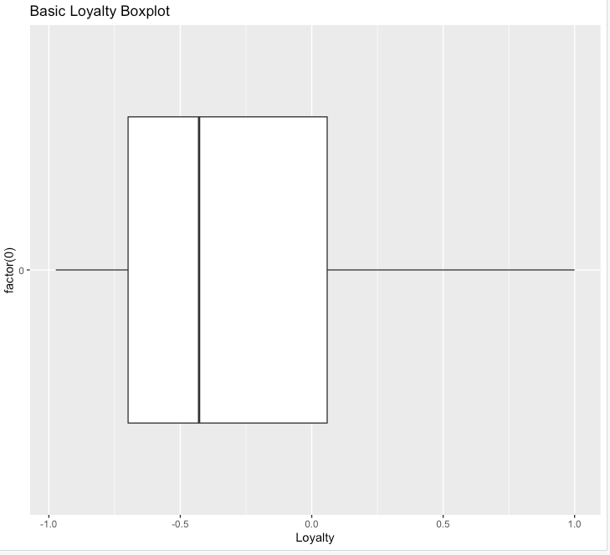
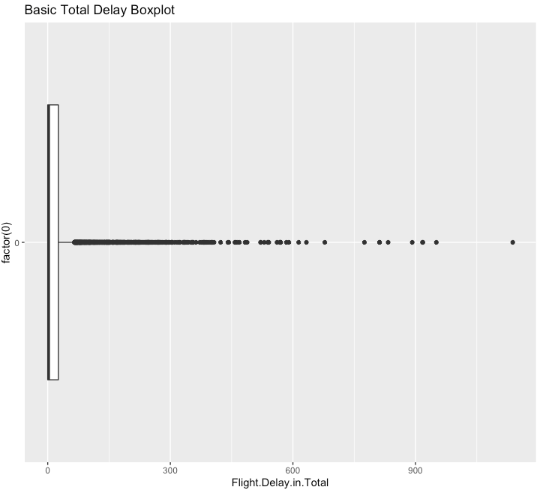
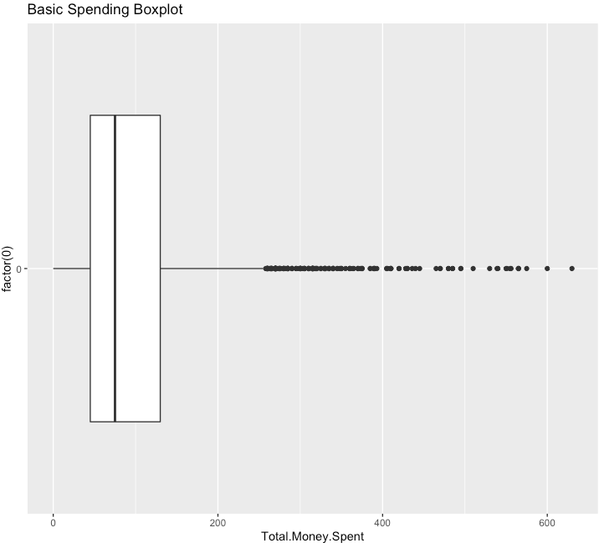
Basic Boxplots
Age
Flights per Year
Loyalty to Southeast
Total Delay Time
Total Spending

Slide 5
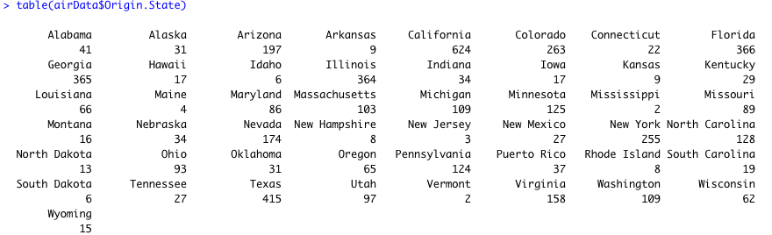



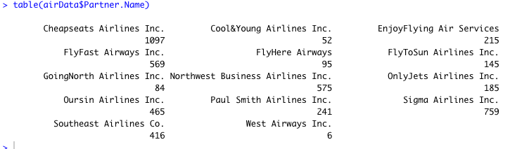


Tables…tables galore!

Slide 6
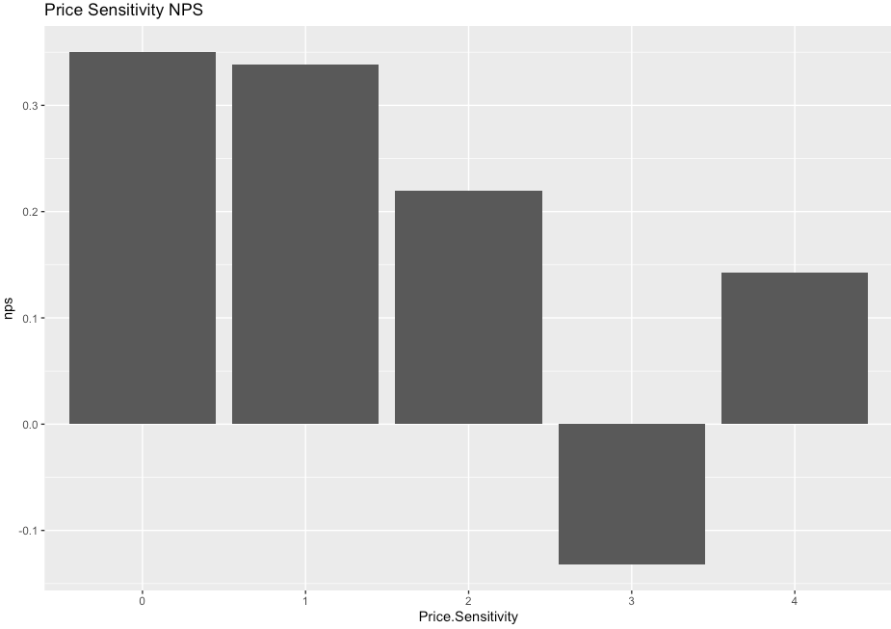
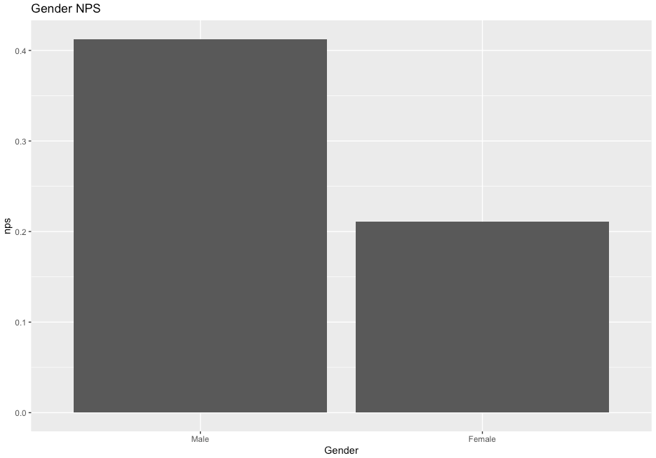
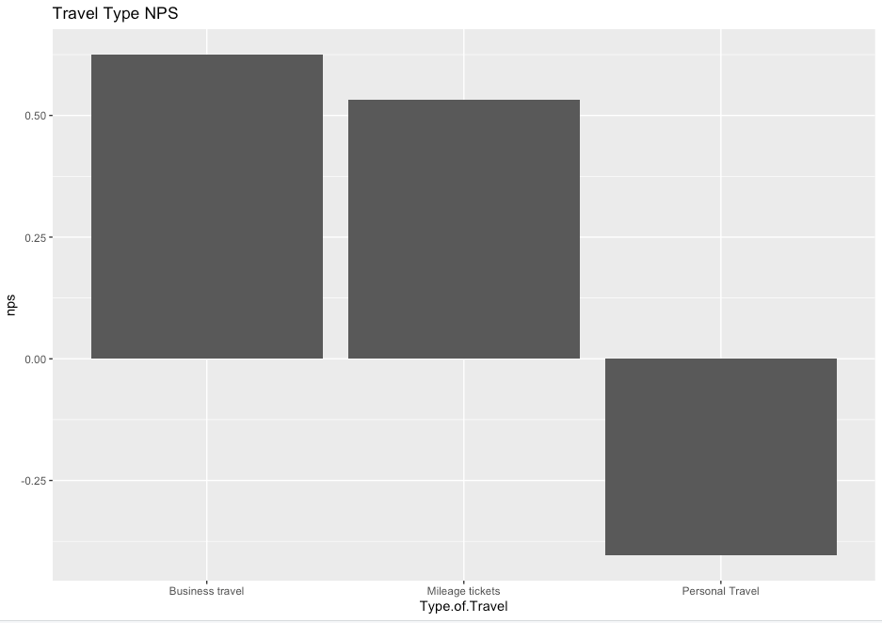
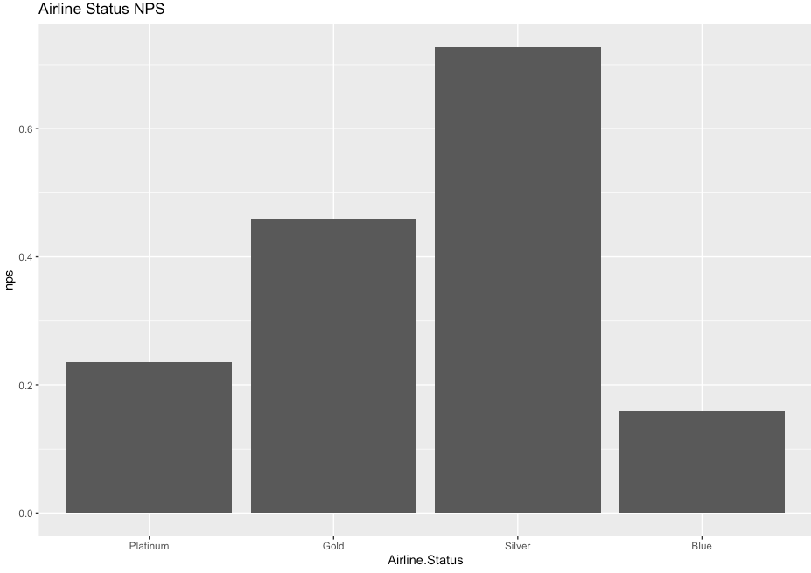
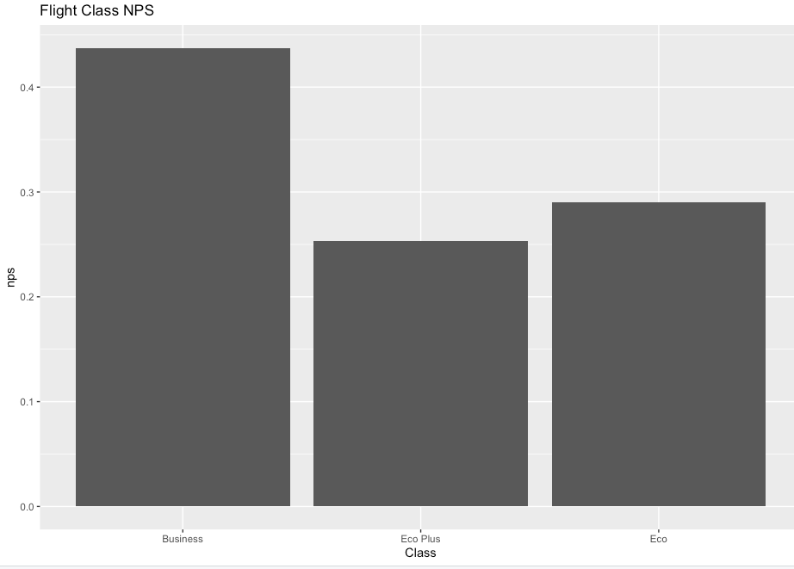
Net Promoter Score Bar Charts
Price Sensitivity
Gender
Travel Type
Airline Status
Class

Slide 7
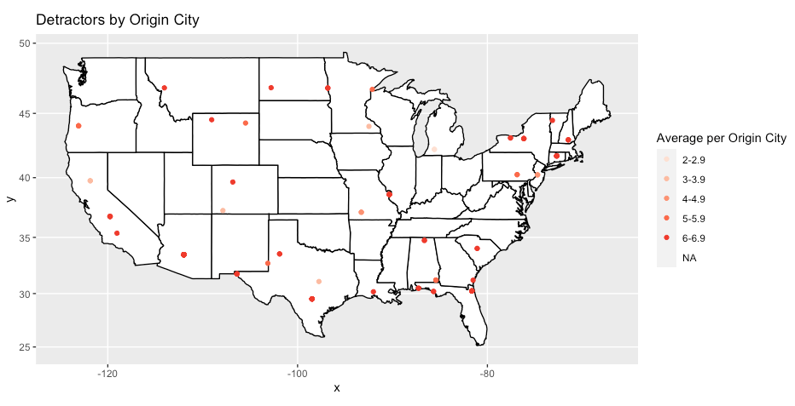
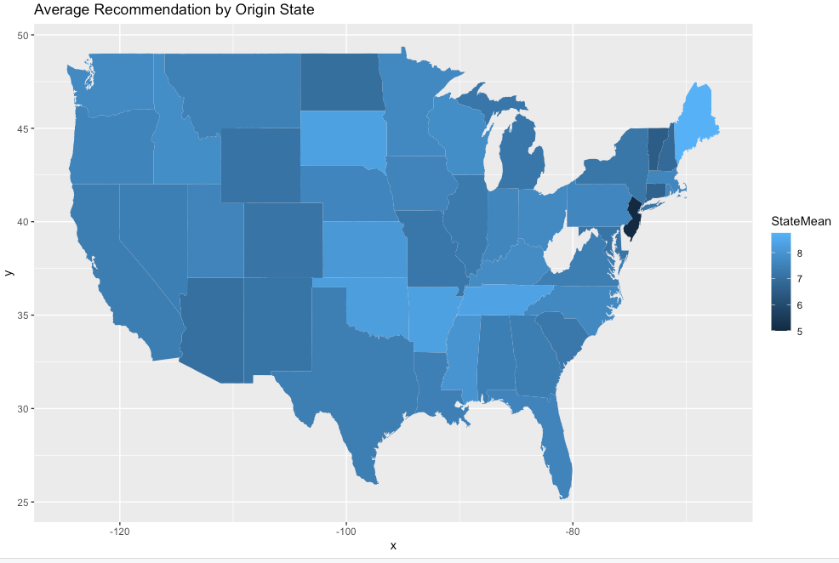
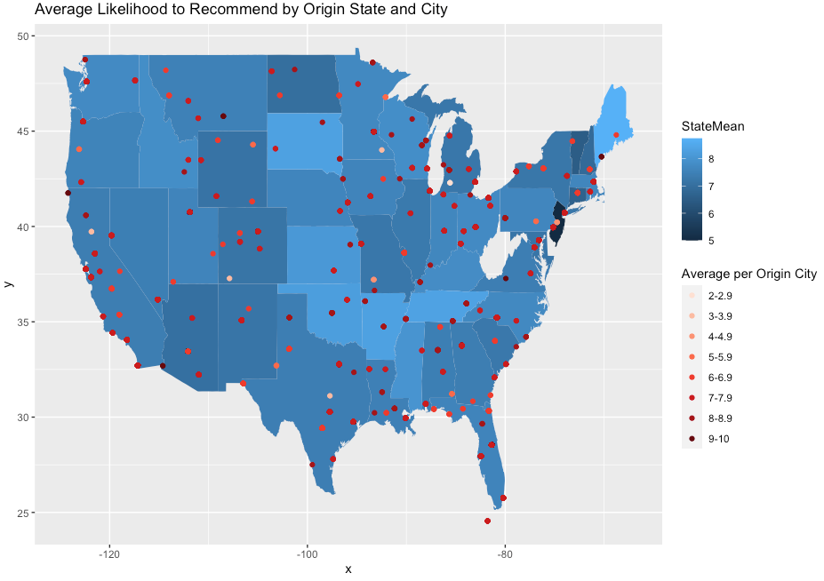
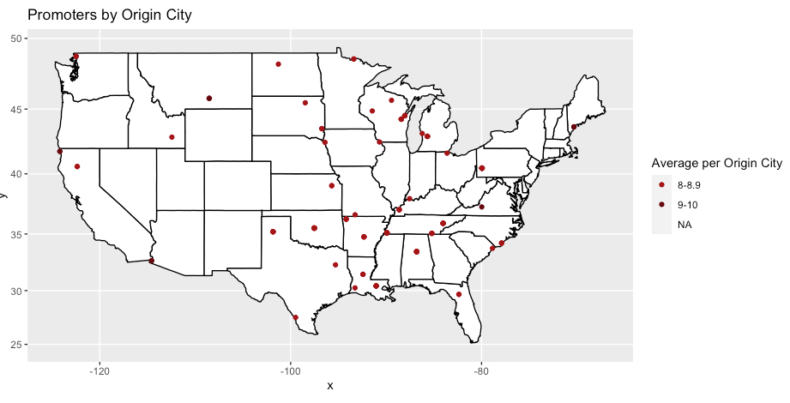
MAPS

Slide 8
Rules to Predict
With a specific command, I was able to determine and return these specific values that help to determine if a person would be a detractor or not.*
Likelihood to Recommend: 0-6
Gender: Female
Airline Status: Blue
Class: Economy
Type of Travel: Personal
Frequent Flyer Accounts: 0-1
*This is probably not all factors that appear in the rules. These are just the ones that I observed and continue the trend.

Slide 9
Linear Models (and what they mean)
Top 4 Independent Variables:
Type of Travel: 33%
Airline Status: 9%
Age: 6%
Gender: 1%
Disclaimer: These values may seem low, and it’s because they are.

Slide 10
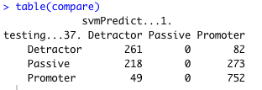
Support Vector Machines
I utilized the NPS Category variable to try and predict whether or not a passenger would be a Detractor, Passive, or a promoter.
After testing multiple different variable to see which had the lowest error margins, I settled on Type of Travel

Slide 11
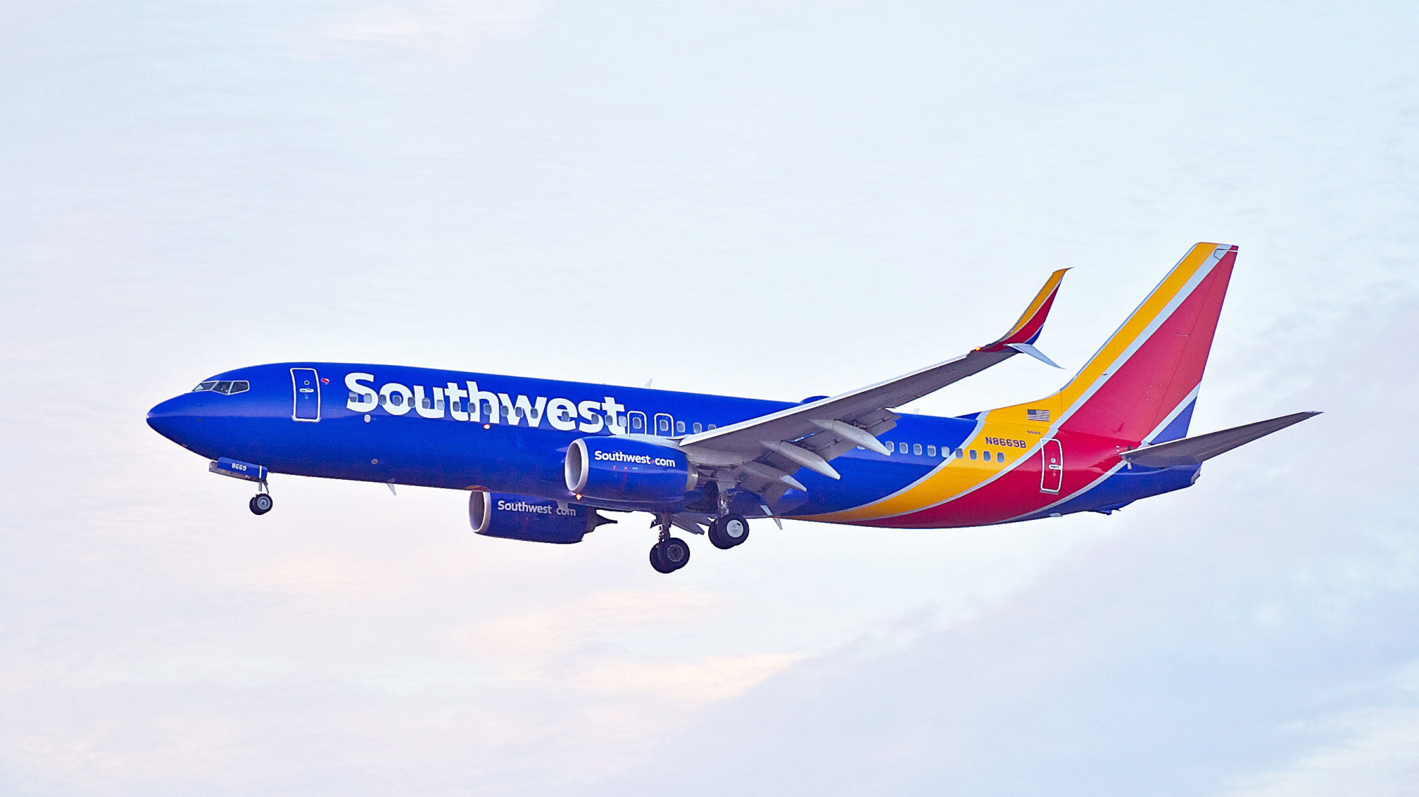
Conclusions
Some of my thoughts…
Focus more on appealing to women
Re-do how your “Blue” status flights feel to consumers
Focus on selling more Frequent Flyer memberships and focus more on selling in the Northeast and out West

